Slide 1

Welcome to the World of
Learning !

Slide 2



Internship Viva Presentation 2024
Topic “Bank Loan Analysis using Power BI”
Submitted By:
BEWESOCIAL Name: Harshita Sancheti Regn. No. 22MCAN123
Name of Faculty Internship Guide Name of Industry Guide
Mr. Manoj Tiwari Kumar Mr. Nikhil Goklani
.

Slide 3
INTERNSHIP VIVA 2024
CONTENTS
Introduction of Company ( brief)
Internship Completion certificate
My Role in the Company
Introduction of Project/Assignment
Methodology & Implementation
Discussion/ Finding/Development
Analysis/ Observations
Outcome of Assignment/Project ( Screenshots etc.)
My Learning's and Experiences
Conclusion
Recommendation to Co. about the Project/Assignment
Collage ( of On site Photographs with Guide and Co. colleagues in office)
References and Bibliography

Slide 4
INTRODUCTION OF COMPANY
BEWESOCIAL is a leading digital marketing agency and social media agency based in Jodhpur, India. Established in 2020, we specialize in providing comprehensive digital marketing solutions to businesses of all sizes.
In addition to digital marketing services, we also offer analytics services using advanced tools such as Power BI and Tableau to provide valuable insights and drive data-driven decisions.
At BEWESOCIAL, we are committed to delivering exceptional results and maximizing the online presence and visibility of our clients.

Slide 5

INTERNSHIP COMPLETION CERTIFICATE

Slide 6
MY ROLE IN THE COMPANY
As a Software Developer Intern, I shall build dynamic and engaging websites using HTML, CSS, and JavaScript. I will learn about various data analytics tools such as Power BI.
By harnessing the power of data visualization and analysis, I have to uncover valuable insights and drive informed decision-making processes.
I have to manage and manipulate large datasets and able to design and optimize database structures, execute complex queries and ensure data integrity and security.
I will gain hands-on experience in building dynamic and interactive websites, incorporating best practices in front-end development to enhance user experience.
I will learn and apply data analytics techniques using tools such as Power BI to visualize and analyze large datasets, extracting valuable insights to inform decision-making processes.

Slide 7
INTRODUCTION TO PROJECT/ASSIGNMENT
The primary objective of this project is to leverage the capabilities of Power BI to conduct a comprehensive analysis of bank loans.
By utilizing Power BI’s advanced visualization and analytics features, we aim to gain insights into various aspects of loan portfolio performance and borrower characteristics.
The project encompasses data collection, preprocessing, analysis, and visualization, culminating in the creation of interactive dashboards that provide stakeholders with actionable insights for strategic decision-making.

Slide 8
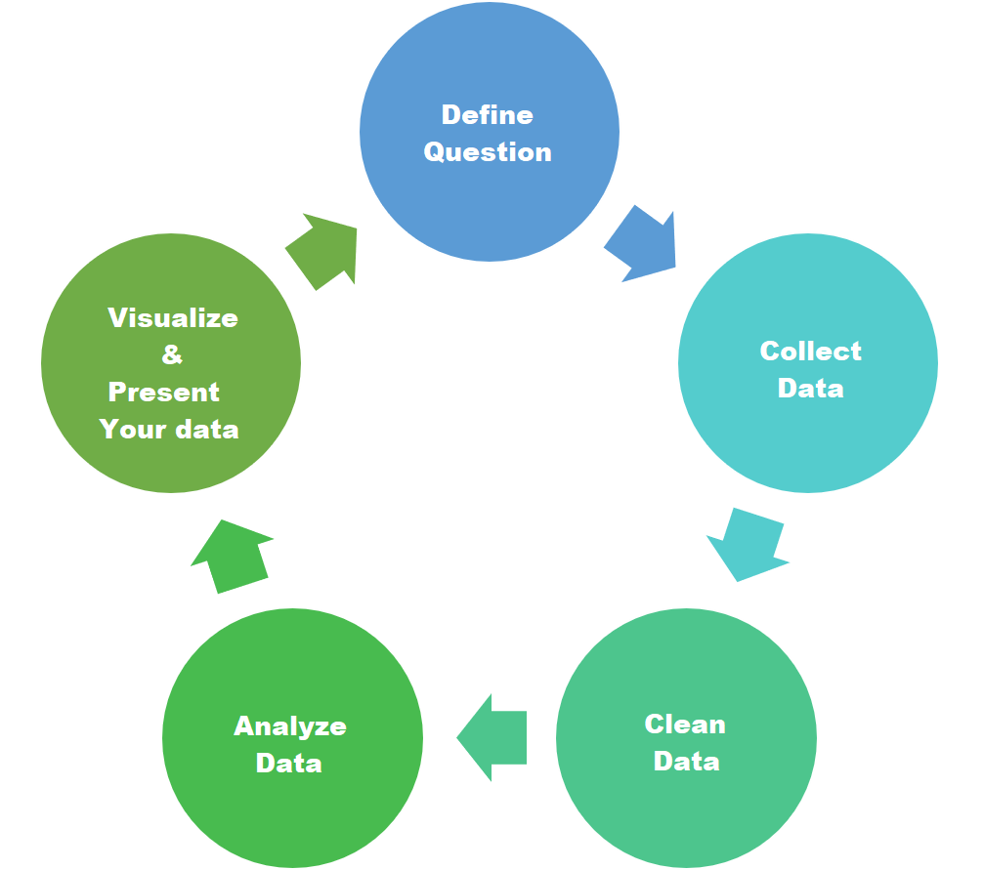
METHODOLOGY & IMPLEMENTATION
Bank Loan Analysis requires a robust methodology encompassing data collection, preprocessing, and analytical techniques to derive meaningful insights.

Slide 9
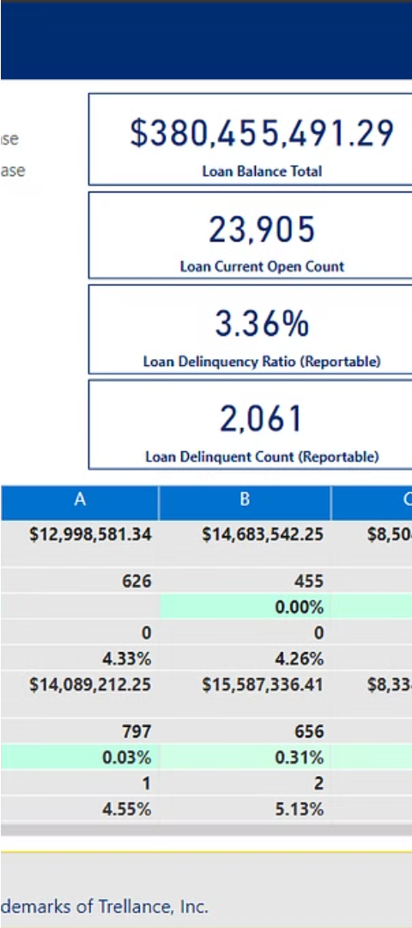
DISCUSSION/ FINDING/DEVELOPMENT
Exploratory Data Analysis
  Borrower Profiles – Analyze customer demographics, including age, income, and credit history, to identify patterns and trends.
  Loan Characteristics – Examine loan details such as amount, interest rate, and repayment terms to uncover insights into the bank’s lending practices.
  Geographical Trends – Visualize the distribution of loans across different regions or branches, identifying potential geographic-specific opportunities or risks.

Slide 10
ANALYSIS/OBSERVATIONS
KPIs (Key Performance Indicators) of Analysis
Total Loan Applications
Total Funded Amount
Measure the total number of loan applications received, providing insights into customer demand.
Track the total amount of funds disbursed to borrowers, indicating the scale of lending activity.
Total Amount Received
Average Interest Rate
Monitor the total amount of loan repayments received, assessing the effectiveness of loan collections.
Calculate the average interest rate charged on loans, reflecting the cost of borrowing for customers.
Average Debt-to-Income Ratio
Analyze the average ratio of borrowers' debt to their income, assessing their creditworthiness and risk.

Slide 11
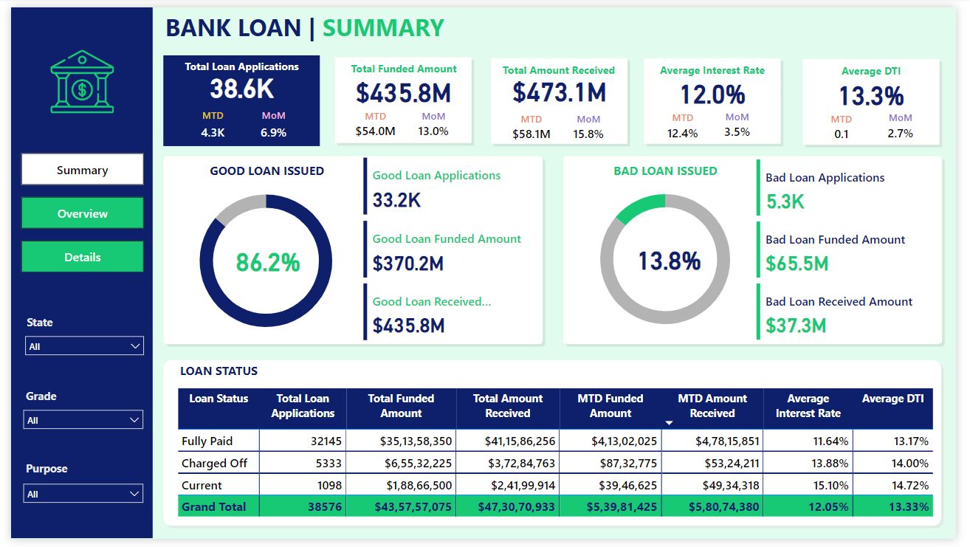
Dashboard - Summary
KPIs
Loan Status Distribution
Good Loan Issued and Bad Loan Issued
Track and compare the total number of loan applications, funds disbursed, and loan repayments received to evaluate loan demand and collections effectiveness.
Examine the distribution of loan statuses to identify any patterns or areas of concern.
Analyze the number and proportion of good loans and bad loans issued to assess lending quality and risk management.

Slide 12
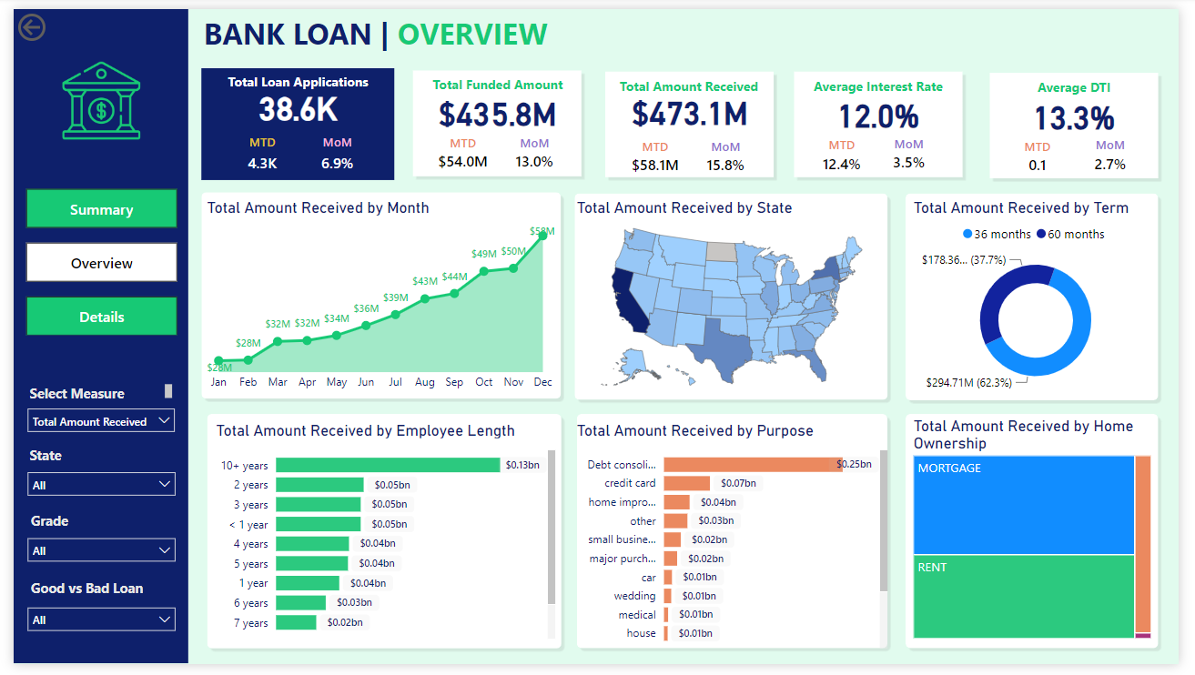
Dashboard - Overview
Monthly Trends
Geographic Analysis
Loan Characteristics
Identify trends and patterns in loan applications, approvals, and disbursements on a monthly basis.
Explore the distribution of loan applications and approvals across different geographic regions.
Analyze the characteristics of loans to understand their impact on loan performance and profitability.

Slide 13
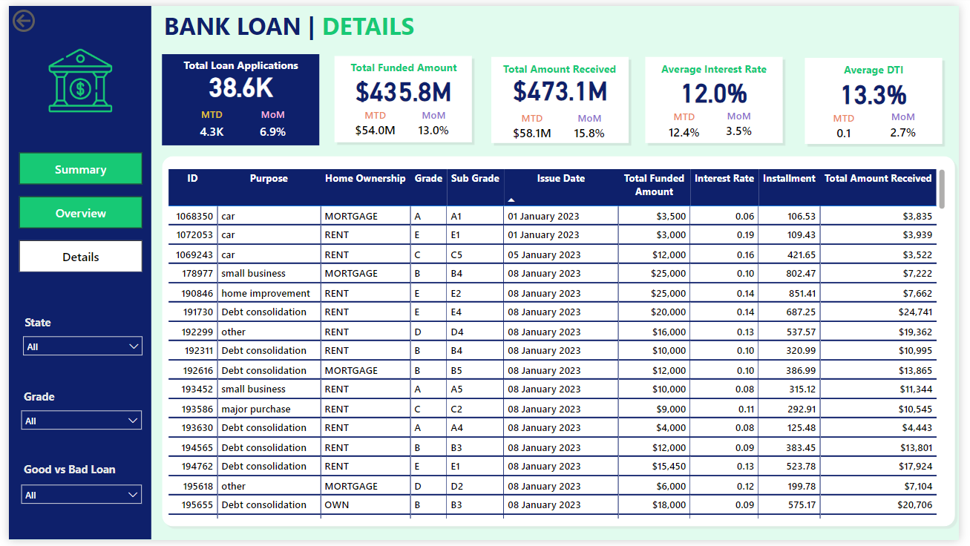
Dashboard – Details
Individual Loan Details
Examine individual loan details to identify any specific trends, patterns, or outliers.

Slide 14
MY LEARNING'S AND EXPERIENCES
What is Data Analysis?
Data analytics is the process of examining and interpreting data to extract valuable insights that can inform decision-making.
It is the process of inspecting, cleaning, transforming, and modeling data to discover useful information, draw conclusions, and support decision-making.
It involves applying various statistical and analytical techniques to uncover patterns, correlations, and trends in the data that can help businesses and organizations make more informed decisions.

Slide 15

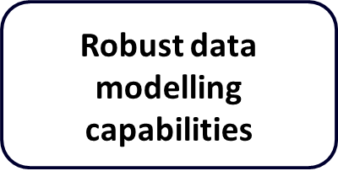
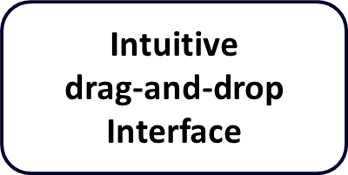
INTRODUCTION TO POWER BI
Power BI is a powerful data visualization and business intelligence tool developed by Microsoft.
It allows users to connect to a wide range of data sources, transform and model the data, and create interactive dashboards and reports.

Slide 16
CAPABILITIES AND BENEFITS OF POWER BI
Key Features of Power BI
Advantages of Using Power BI
Robust data connectivity to access a wide range of data sources.
Advanced data modeling capabilities to build complex data models.
Powerful visualization tools to create compelling and insightful dashboards.
Collaborative features for sharing and presenting insights across the organization.
Intuitive and user-friendly interface for easy data exploration.
Seamless integration with Microsoft Office and other data platforms.
Scalable solution to handle growing data volumes and organizational needs.
Accessible business intelligence capabilities for users across the company.

Slide 17

DATA PREPARATION AND CLEANING
1
Data Extraction
Retrieve relevant data from the bank's internal systems
and external sources, ensuring a comprehensive dataset
for analysis.
2
Data Cleaning
Identifying and addressing data quality issues, including incomplete, inconsistent, or duplicated information.
3
Data Integration
Combine multiple data sources into a unified dataset,
enabling a holistic view of the bank's loan portfolio.

Slide 18
DATA MODELING AND TRANSFORMATION
Data Extraction – Collecting and extracting data from various sources, such as banking systems, customer databases, and financial records.
Data Transformation – Clean and standardize the data, addressing inconsistencies, missing values, and outliers to ensure data integrity.
Data Modeling – Designing an efficient data model that represents the relationships and dependencies within the bank’s lending portfolio.

Slide 19
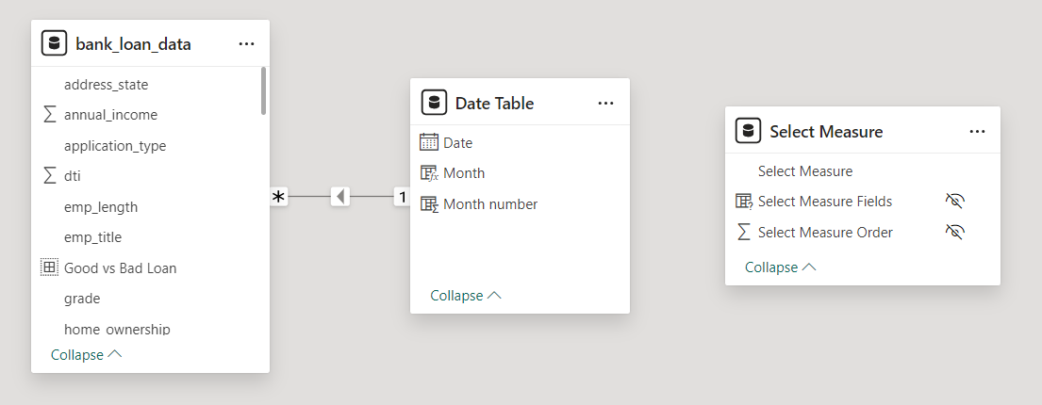
FEATURE ENGINEERING
Insight Generation
Complexity Reduction
Transformation
Derive new variables to capture additional insights, enhancing predictive modelling performance.
Apply mathematical functions to variables, transforming data to meet specific analytical requirements and enhance model accuracy.
Aggregate data to simplify analysis and improve model interpretability.

Slide 20
IMPLICATIONS FOR THE BANKING INDUSTRY
Risk Management – Incorporating loan status distribution insights enables targeted risk mitigation
Strategies enhancing overall risk management effectiveness.
Customer Segmentation – Analyzing loan characteristics and borrower demographics enables banks
To personalize products and services, fostering satisfaction and loyalty.
Market Expansion – Analyzing geographic distribution data guides banks’ expansion efforts and
Reveals new market opportunities for strategic resource allocation.
Operational Efficiency – Using Power BI streamlines data analysis, enhancing operational
Efficiency and enabling faster, data-driven decision-making in banks.

Slide 21
CONCLUSIONS
Summary of findings – The Power BI analysis uncovered key insights into the bank’s loan portfolio
Performance, borrower characteristics, regional variations, and granular loan details, enabling data-
Driven risk management and customer segmentation strategies.
Significance of the Project – The initiative demonstrated the transformation impact of advanced data
Analytics, empowering the bank to enhance risk management, improve customer experiences, and
Drive operational efficiency.
Recommendations – Future enhancements should explore predictive modeling, integrate
Additional data sources, ensure regulatory compliance, and implement real time monitoring
Capabilities for proactive decision-making.

Slide 22





COLLAGE

Slide 23
BIBLIOGRAPHY AND REFERENCES
1. Altman, E. I. (1968). Financial ratios, discriminant analysis and the prediction of corporate bankruptcy. *Journal of Finance*, 23(4), 589-609.
2. Basel Committee on Banking Supervision. (2010). Basel III: A global regulatory framework for more resilient banks and banking systems. Bank for International Settlements.
3. Microsoft. (n.d.). [Power BI Documentation]
4. Moody's Analytics. (2020). [RiskCalc™ Credit Risk Modeling and Validation]
5. RStudio Team. (2020). [RStudio: Integrated Development for R]
6. U.S. Securities and Exchange Commission. (2020). [EDGAR - Electronic Data Gathering, Analysis, and Retrieval]
7. World Bank. (2020). [World Bank Open Data]
9. Market Trends Report 2023: ABC Financial Services.

